Slide 1
Team 1 Lab 2 Oral Briefing
Clementine Mitchell, Martina Stadler, Nick Villanueva, Samir Wadhwania, Jake Liguori, Jose Gomez

Slide 2
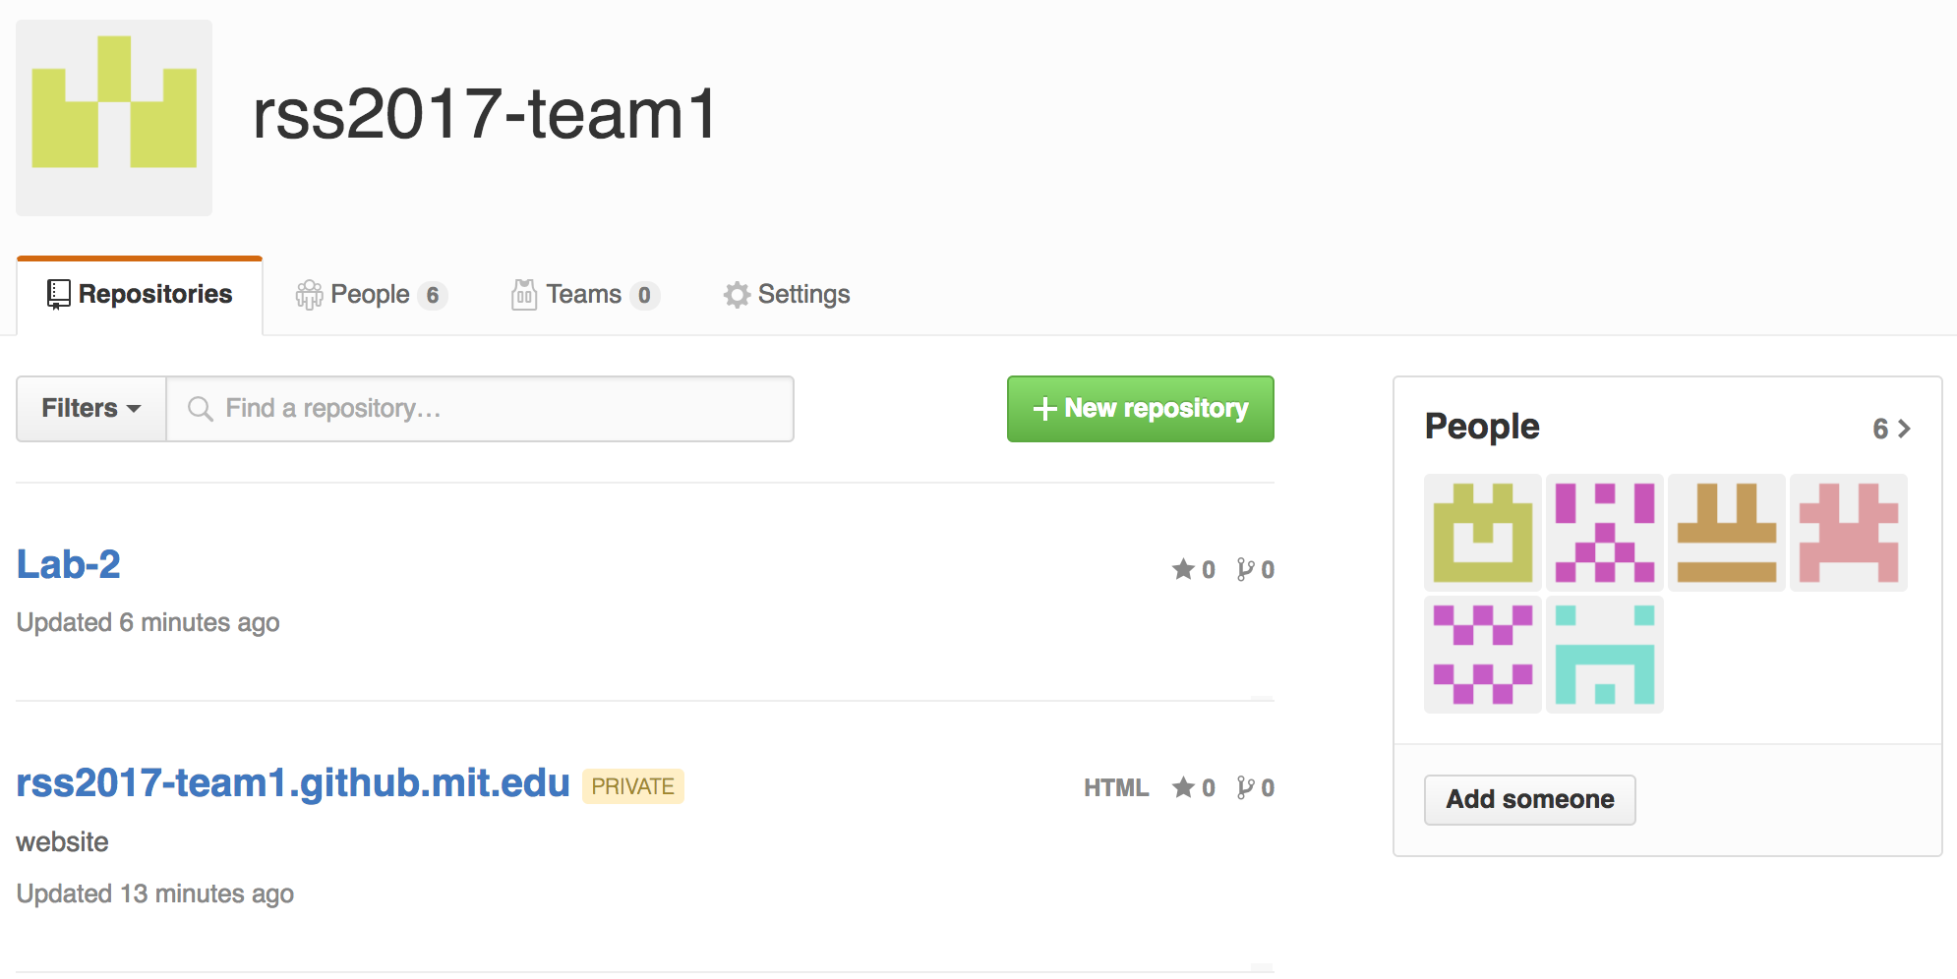
Setting up GitHub
Three steps:
Set up git environment in terminal
Access tokens
Create team organization
rss2017-team1
Create repositories for labs and website
Lab-2
rss2017-team1.github.mit.edu
Notes:
(Samir)
Issues before/after Lab 2 Errata sent out

Slide 3
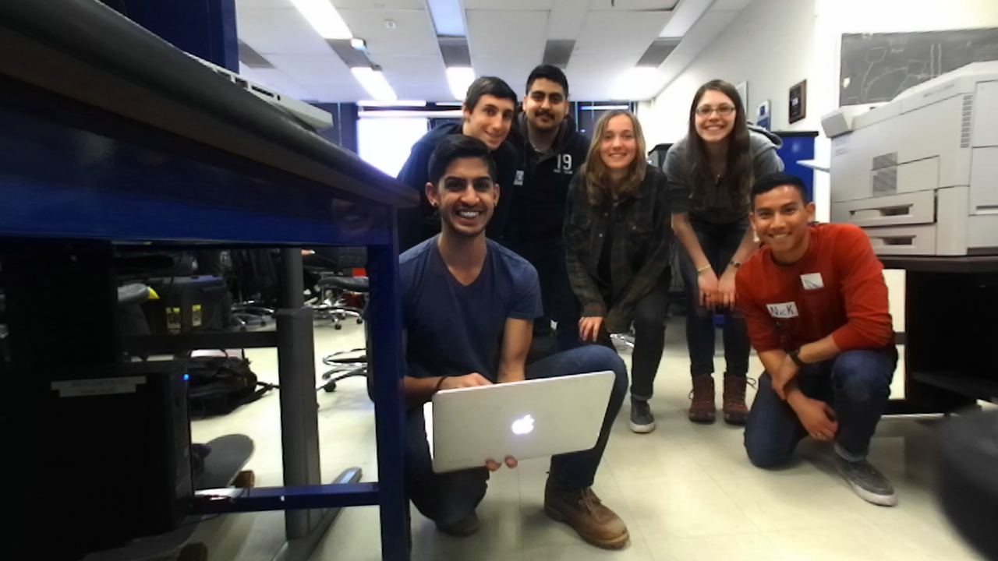
Creating the Team Website
Three pages: Home/About/Labs
Home: Links to department, class, and team Github repository.
About: Team introduction and individual member bios.
Labs: Page per Lab containing embedded report and oral briefing
Notes:
Jose

Slide 4
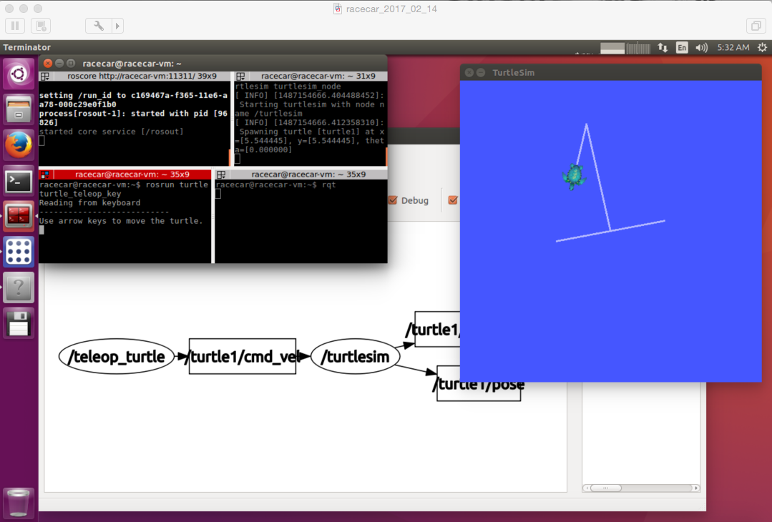
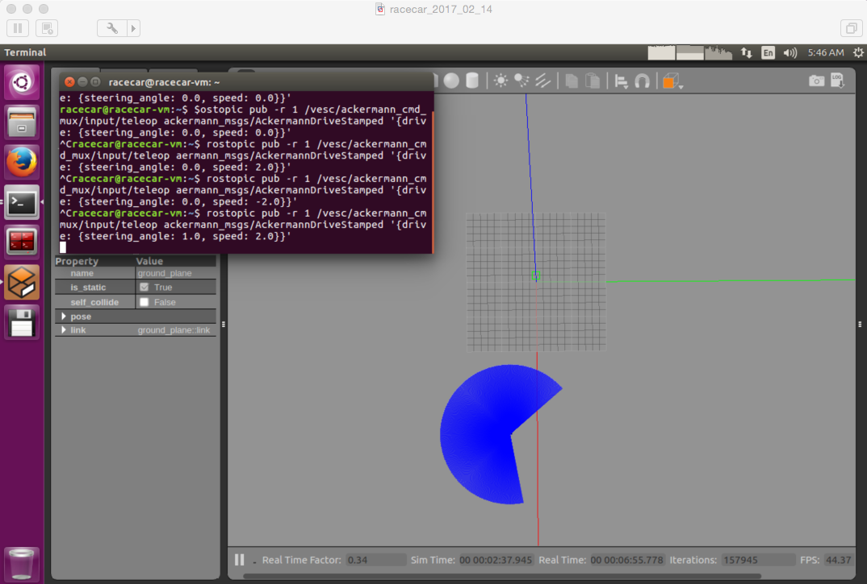
Running the Simulation
Familiarity Using TurtleSim, Node Graph Experience Using Race Car Simulation
Notes:
Jake Liguori
-After setting up computers, began getting comfortable with using the VM, command line, and ROS software
-Turtlesim, Node graph
-Can see how the software interprets commands and, more importantly, how we will have to change nodes and topics in order to get the robot to do what we want it to do
-Both on command line and in launch scripts
-Practice here made running the gazebo simulation much more useful and fun

Slide 5
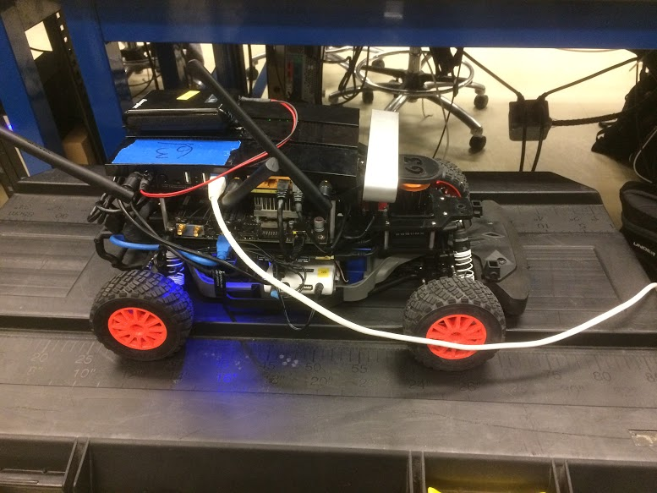
Running the Simulation with the Joypad
We remapped the topic /ackermann_cmd_mux/input/teleop to the topic /vesc/ackermann_cmd_mux/input/teleop in order to be able to control the racecar with the joypad.
We did this first in the simulator and then confirmed functionality on the hardware.
Joypad receiver was inserted into the back of our racecar.
Notes:
Clemmie
Joystick issues?
Why the remap did things - the vesc/ackermann topic actually published to the correct node (joy_teleop to controller to servo commands)

Slide 6
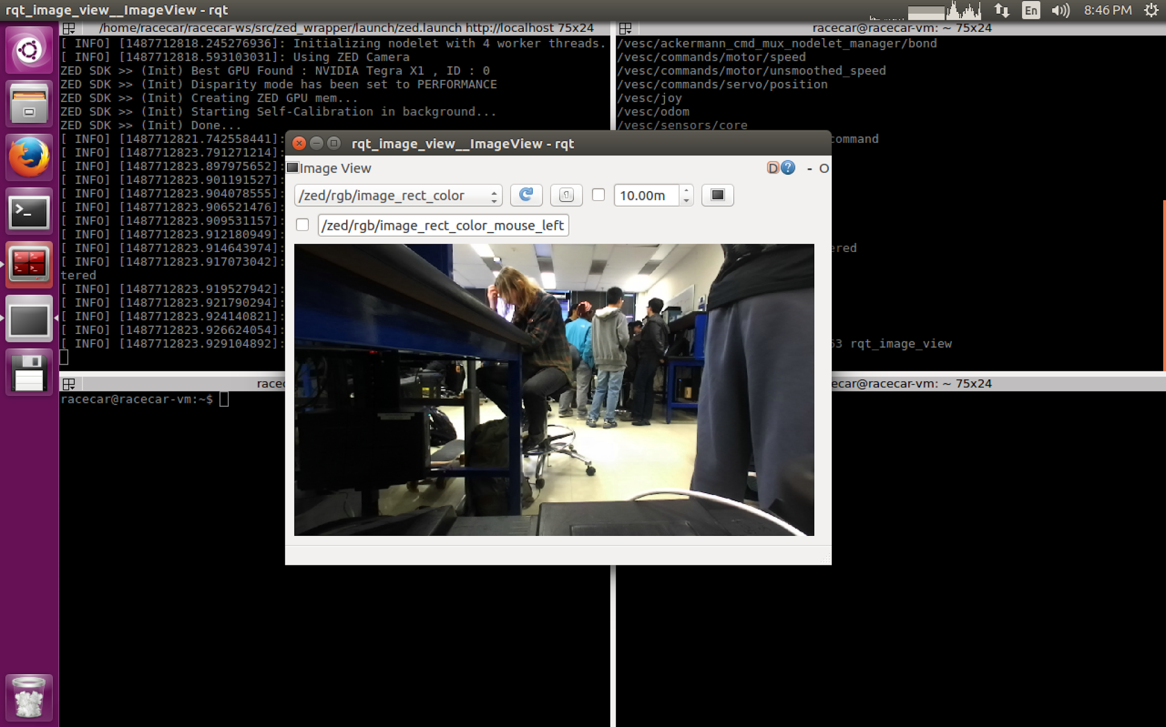
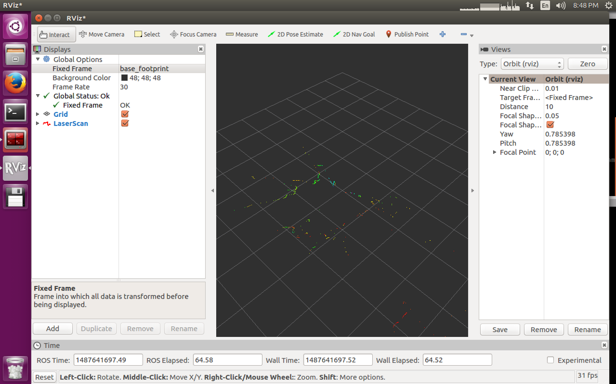
Streaming and Collecting Data
Zed image streaming
Laserscanner data
Notes:
Nick Villanueva
The next portion of the lab involved streaming data from the racecar. First, we powered on the onboard router and Jetson computer. Once these booted up, we tested our connection and then ssh’ed into the racecar. We could then start the camera and stream images to our computers. We could then do the same for the laserscanner data.

Slide 7
Lessons Learned
Technical:
Jiggle cables
Create test cases to define and analyze expectations
Controller issue
CI:
Meeting is a schedule challenge
Clearly articulate goals, priorities, and expectations
Define individual tasks
Allows for parallelization
Ensure everyone is aware what is happening
Use platform for communication
Slack

Slide 8
Questions?

